Slide 1
Snowflake

Slide 2
Contents
Database architecture?
Introduction to Snowflake
Multi-cluster, shared data architecture
Data architecture
Virtual Warehouses
Query pruning
Micro-partitions (benefits)
Data Clustering
Semi structured data support
Comparison between Snowflake and MongoDB and SQL Server
Notes:
E-commerce Platforms:
Healthcare Analytics
Gaming and Entertainment: user interactions, game analytics, and content consumption
#resources (cpu, cache, data storage) & time
#users (concurrency) & data processing → elasticity

Slide 3
Database architecture?
Complexity: Managing both infrastructure as well as data
Limited scalability Can’t support all data, users, workload
Rigid costs Keep on the lights 24/7
Inadecuate Elasticity Stuck with rigid inflexible architectures
Notes:
E-commerce Platforms:
Healthcare Analytics
Gaming and Entertainment: user interactions, game analytics, and content consumption
#resources (cpu, cache, data storage) & time
#users (concurrency) & data processing → elasticity

Slide 4
Introduction to Snowflake
A cloud-based data warehousing platform designed to handle large volumes of data and enable organizations to store, manage, and analyze their data efficiently.
Multi-Cloud Support: Snowflake supports major cloud platforms, including AWS, Azure, and Google Cloud, offering flexibility and choice to users.
Unique Architecture: Snowflake's architecture is built on a multi-cluster, shared data architecture, providing advantages in terms of separation of storage and compute.
Notes:
One platform to store all data regardles of the structure
without having to manage infrastructure
Getting data live from the provider. Bring in extra data to enrich internal data sets

Slide 5
Multi-cluster, shared data architecture
Multi-cluster:
In Snowflake's architecture, multiple compute clusters, also known as virtual warehouses, can operate concurrently.
Each virtual warehouse is a set of compute resources that can process queries and perform data operations independently of other warehouses.
The multi-cluster aspect allows Snowflake to handle high concurrency, with multiple users or workloads running simultaneously without interference.
Shared data:
The data in Snowflake is stored separately from the compute resources. It resides in cloud-based object storage, such as Amazon S3, Azure Blob Storage, or Google Cloud Storage.
Multiple virtual warehouses share access to the same underlying data, promoting collaboration and avoiding data duplication.
Data is stored in a columnar format, and Snowflake employs a metadata layer to manage and organize this data efficiently.
Notes:
, compute clusters (virtual warehouses) are used to process SQL queries and analytics tasks concurrently.
Parallel Processing: Task Distribution: Load Balancing: Fault Tolerance:
Many compute clusters are designed with fault-tolerant features to ensure continued operation in the event of node failures.
Fault tolerance mechanisms may include data replication, node redundancy, or automatic failover.

Slide 6
Data architecture
The Snowflake data warehouse architecture has three layers
Database Storage Layer
Snowflake saves and manages data on the cloud using a shared-disk approach, making data management simple.
Query Processing Layer
For query execution, Snowflake uses the Virtual Warehouse. The query processing layer is separated from the disk storage layer in the Snowflake data architecture. You can use the data from the central storage layer to run queries in this layer.
Cloud Services Layer
The cloud services layer contains all of the operations that coordinate throughout Snowflake, such as authentication, security, data management, and query optimization. A cloud service is a stateless computing resource that operates across different availability zones and uses highly accessible and usable information. The cloud services layer provides a SQL client interface for data operations such as DDL and DML.
Notes:
In a shared-disk architecture, multiple compute nodes (or clusters) share access to a common storage layer.

Slide 7
Virtual Warehouses
A virtual warehouse, often referred to simply as a “warehouse”, is a cluster of compute resources in Snowflake.
A warehouse provides the required resources, such as CPU, memory, and temporary storage, to perform the following operations in a Snowflake session:
Executing SQL SELECT statements that require compute resources (e.g. retrieving rows from tables and views).
Performing DML operations, such as:
Updating rows in tables (DELETE , INSERT , UPDATE).

Slide 8
Query pruning
Query pruning is a Snowflake query optimization technique that involves reducing the amount of data that must be scanned during query execution. It accomplishes this by utilizing the power of the Snowflake micro-partitions that make up a table to determine which ones contain relevant data and which ones can be skipped.
Notes:
query optimization technique
Limiting the amount of data dat must be scanned when a query is executed.
So, when you run a query in Snowflake,
it gets split up into little chunks and distributed across multiple compute nodes.
Each of these tasks is responsible for processing a specific set of data,
which is determined based on the query's filter predicates.
Using statistics on the micro-partitions, Snowflake can skip over partitions that do not contain relevant data and only process the ones that do.
This significantly reduces the amount of data that needs to be scanned, resulting in faster and more efficient queries.

Slide 9
Micro-partitions
All data in Snowflake tables is automatically divided into micro-partitions, which are contiguous units of storage.
Each micro-partition contains between 50 MB and 500 MB of uncompressed data
Groups of rows in tables are mapped into individual micro-partitions, organized in a columnar fashion.
This size and structure allows for extremely granular pruning of very large tables, which can be comprised of millions, or even hundreds of millions, of micro-partitions.
Notes:
(note that the actual size in Snowflake is smaller because data is always stored compressed).
a query that specifies a filter predicate on a range of values that accesses 10% of the values in the range should ideally only scan 10% of the micro-partitions.
Snowflake uses columnar scanning of partitions so that an entire partition is not scanned if a query only filters by one column.

Slide 10
Micro-partitions: benefits
In contrast to traditional static partitioning, Snowflake micro-partitions are derived automatically; they don’t need to be explicitly defined up-front or maintained by users.
Micro-partitions are small in size (50 to 500 MB, before compression), which enables extremely efficient DML and fine-grained pruning for faster queries.
Micro-partitions can overlap in their range of values, which, combined with their uniformly small size, helps prevent data skew.
Columns are stored independently within micro-partitions, often referred to as columnar storage. This enables efficient scanning of individual columns; only the columns referenced by a query are scanned.
Columns are also compressed individually within micro-partitions. Snowflake automatically determines the most efficient compression algorithm for the columns in each micro-partition.
Notes:
Data skew refers to an
imbalance in the distribution of data across partitions,
uneven processing
and performance issues.

Slide 11
What is Data Clustering?
Typically, data stored in tables is sorted/ordered along natural dimensions (e.g. date and/or geographic regions). This “clustering” is a key factor in queries because table data that is not sorted or is only partially sorted may impact query performance, particularly on very large tables.
In Snowflake, as data is inserted/loaded into a table, clustering metadata is collected and recorded for each micro-partition created during the process. Snowflake then leverages this clustering information to avoid unnecessary scanning of micro-partitions during querying, significantly accelerating the performance of queries that reference these columns.

Slide 12
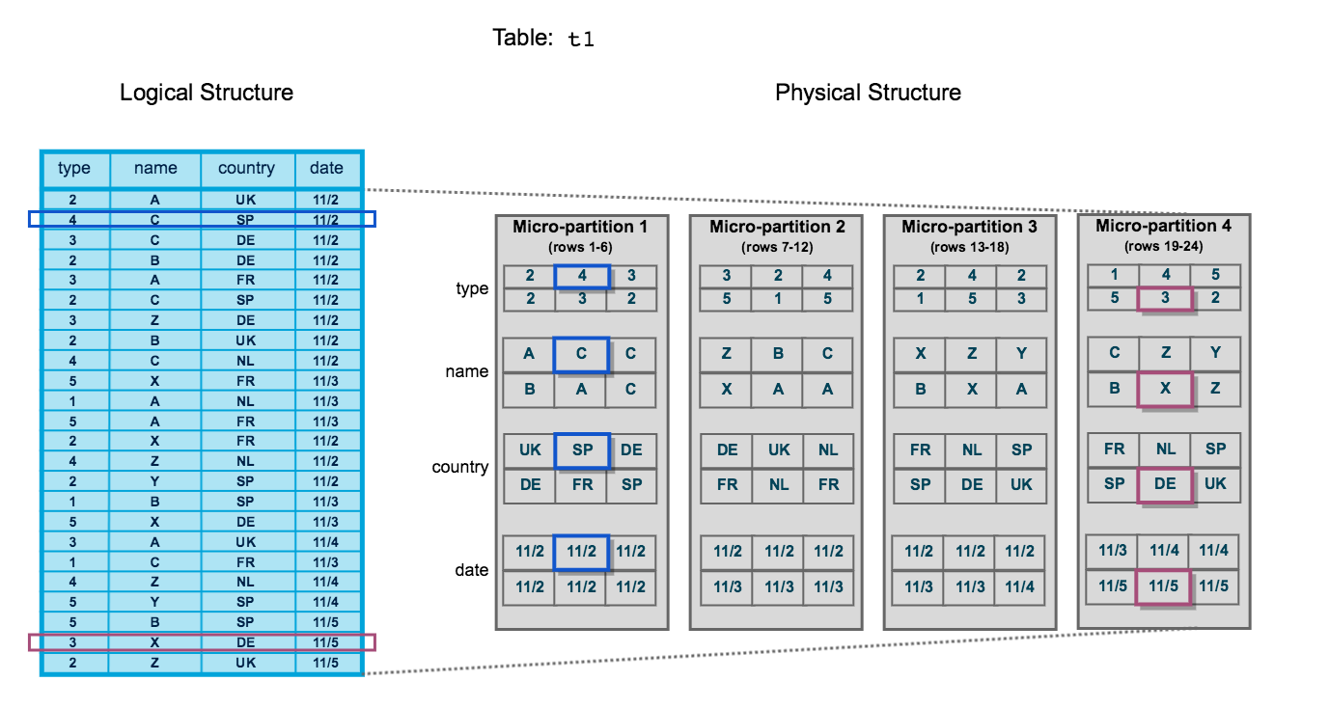
Notes:
The table consists of 24 rows stored across 4 micro-partitions, with the rows divided equally between each micro-partition.
Within each micro-partition, the data is sorted and stored by column, which enables Snowflake to perform the following actions for queries on the table:
First, prune micro-partitions that are not needed for the query.
Then, prune by column within the remaining micro-partitions.

Slide 13
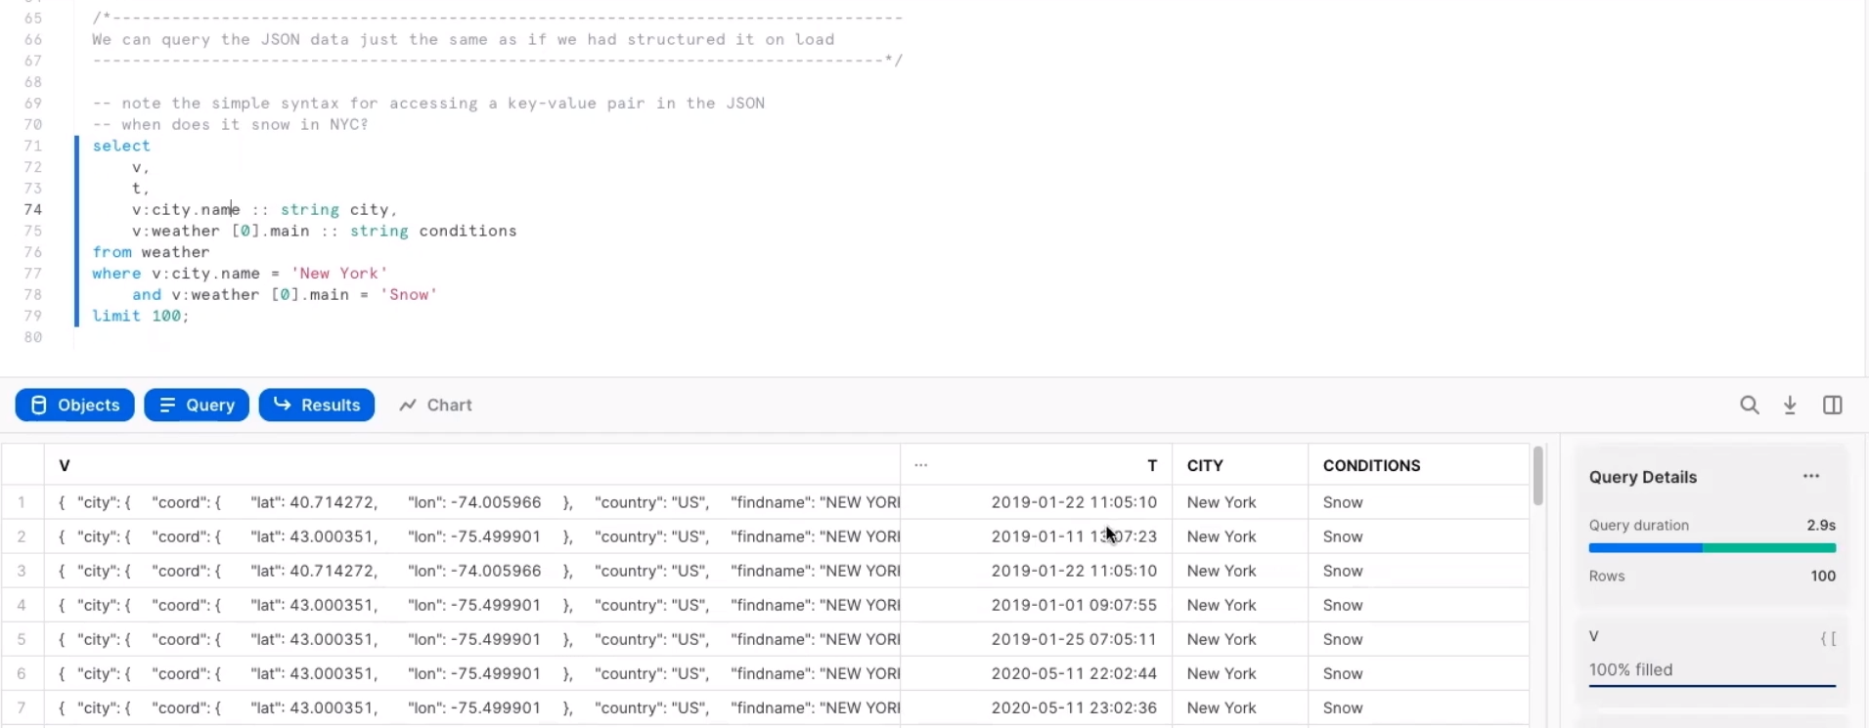
Semi structured data support
Notes:
One can use basic sql to query this, go to ‘V’ column, find city.name key and cast that value as a string. Without changing underlying file

Slide 14
 | Datamodel | Architecture | Key Features | Use case
Snowflake | Type: Data Model: Tables and views with defined schemas. Storage Format: | Architecture: Scalability: Storage: | Key Features: Multi-cluster, shared data architecture, data sharing, zero-copy cloning, real-time analytics. Notable: | Use Cases: Data warehousing, analytics, data sharing, collaborative projects. Strengths:
SQL Server | Type: Relational database. Data Model: Tables with defined schemas. Storage Format: Row-based storage. | Architecture: Traditional client-server architecture. Scalability: Vertical scaling by adding more resources (CPU, RAM) to a single server. Storage: Typically uses traditional disk-based storage. | Key Features: ACID compliance, support for stored procedures, triggers, and complex transactions. Notable: Robust relational database features, integration with Microsoft ecosystem. | Use Cases: Traditional relational database applications, transactional systems. Strengths: ACID compliance, support for complex transactions.

Slide 15
 | Datamodel | Architecture | Key Features | Use case
Snowflake | Type: Relational database with support for structured and semi-structured data. Data Model: Tables and views with defined schemas. Storage Format: Stored in a columnar format. | Architecture: Multi-cluster, shared data architecture with separate storage and compute layers. Scalability: Elastic scalability with the ability to scale storage and compute independently. Storage: cloud-based object storage | Key Features: Multi-cluster, shared data architecture, data sharing, zero-copy cloning, real-time analytics. Notable: Separation of storage and compute, automatic scaling. | Use Cases: Data warehousing, analytics, data sharing, collaborative projects. Strengths: Handling large-scale analytics, separation of storage and compute.
SQL Server | Type: Relational database. Data Model: Tables with defined schemas. Storage Format: Row-based storage. | Architecture: Traditional client-server architecture. Scalability: Vertical scaling by adding more resources (CPU, RAM) to a single server. Storage: Typically uses traditional disk-based storage. | Key Features: ACID compliance, support for stored procedures, triggers, and complex transactions. Notable: Robust relational database features, integration with Microsoft ecosystem. | Use Cases: Traditional relational database applications, transactional systems. Strengths: ACID compliance, support for complex transactions.

Slide 16
 | Datamodel | Architecture | Key Features | Use case
Snowflake | Type: Relational database with support for structured and semi-structured data. Data Model: Tables and views with defined schemas. Storage Format: Stored in a columnar format. | Architecture: Multi-cluster, shared data architecture with separate storage and compute layers. Scalability: Elastic scalability with the ability to scale storage and compute independently. Storage: cloud-based object storage | Key Features: Multi-cluster, shared data architecture, data sharing, zero-copy cloning, real-time analytics. Notable: Separation of storage and compute, automatic scaling. | Use Cases: Data warehousing, analytics, data sharing, collaborative projects. Strengths: Handling large-scale analytics, separation of storage and compute.
MongoDB | Type: NoSQL document database. Data Model: Collections of JSON-like documents (BSON format). Storage Format: BSON (Binary JSON) format. | Architecture: Distributed, horizontal scaling with sharding for data distribution. Scalability: Scales horizontally by adding more servers to a MongoDB cluster. Storage: Data is distributed across shards, and each shard is a replica set. | Key Features: JSON-like document model, horizontal scaling through sharding, flexible schema. Notable: NoSQL flexibility, automatic sharding. | Use Cases: Document-oriented applications, real-time applications, content management systems. Strengths: Flexible schema, scalability for write-intensive workloads.

Slide 17
Use cases for Snowflake
Data warehousing
Centralized Data Storage
Snowflake serves as a centralized repository for storing and managing large volumes of structured and semi-structured data. It facilitates efficient data warehousing for analytics.
Data sharing
Secure Collaboration
Organizations can securely share data with external partners, customers, or other departments. This feature is valuable for collaborative projects and data monetization strategies.
Advanced analytics
Complex Analytics and Reporting
Snowflake's high-performance analytics capabilities make it suitable for running complex queries, data exploration, and generating insightful reports.

